Slide 1

Multiplex de Bruijn graphs enable genome assembly from long, high-fidelity reads
Journal Club, Cem Güleç
July 07, 2022

Slide 2
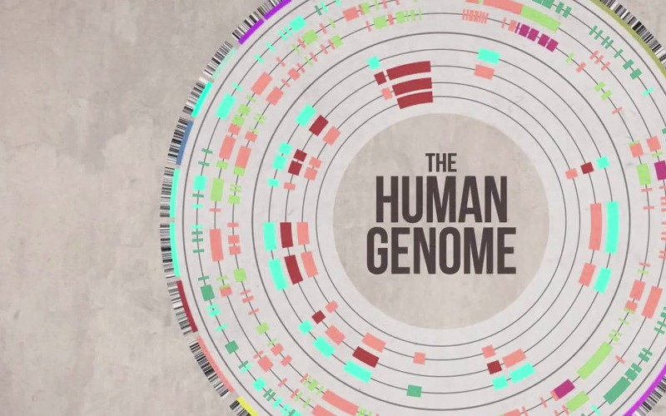
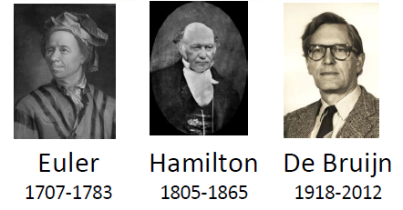
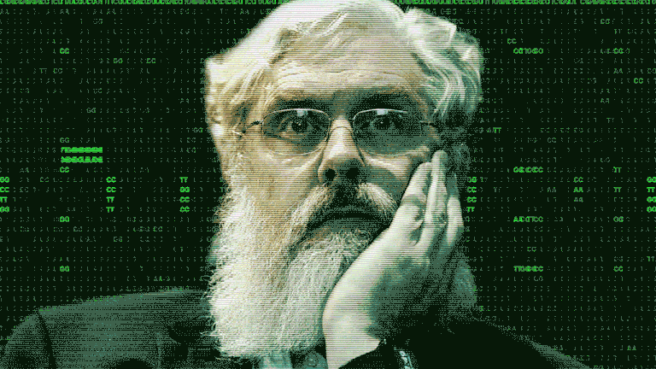
Big Question
Genome sequencing
Genome assemblers
Notes:
Grand challenge of decyphring longest «book» in the world
insan genomunun gizemlerinden bahsedilen, biyolojik taraftan bir giriş

Slide 3
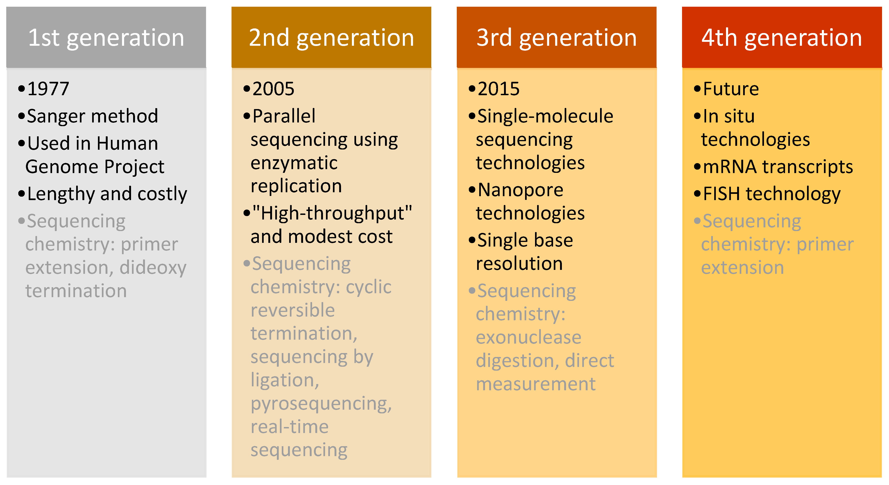
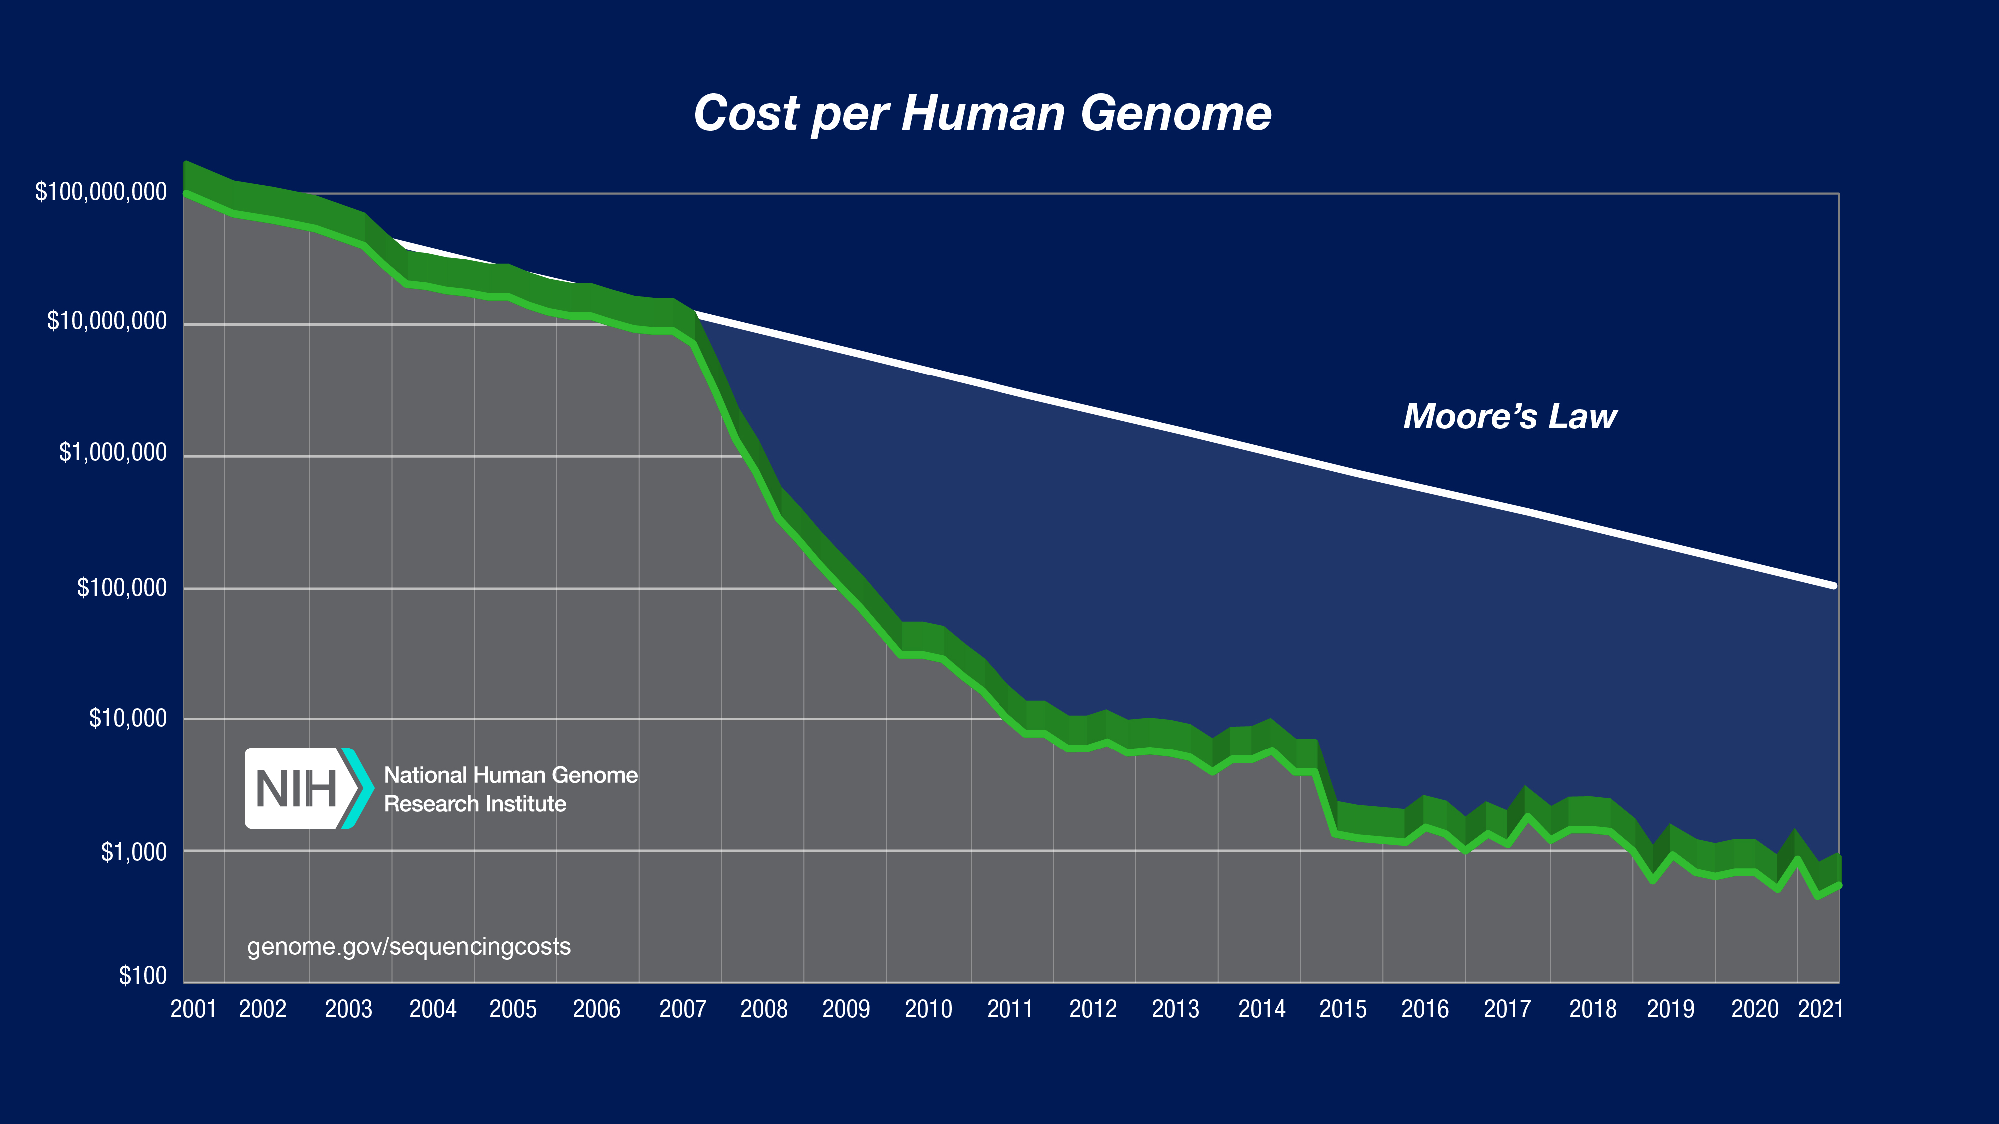
History of genomics
1977: Walter Gilbert and Frederick Sanger develop independent DNA sequencing methods. - which then resulted with a Nobel Prize.
Late 2000s: Illumina reduces the cost of sequencing a human genome from $3 billion to $10,000.

Slide 4
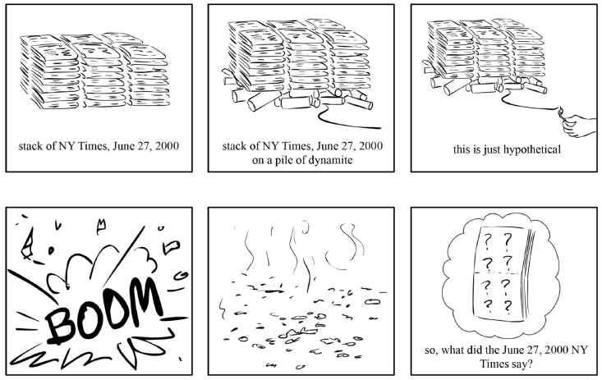
Take another look: Exploding newspaper anology

Slide 5

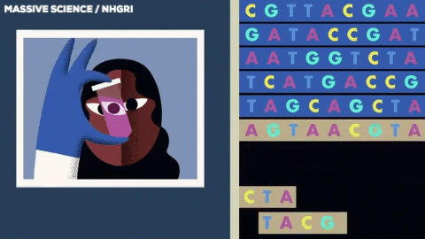
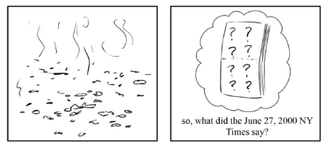

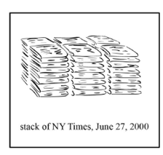
String reconstruction problem-blackbox
ALGORITHM
Reconstruct a string from its k-mer composition.
Input: A collection of k-mers.
Output: A genome such that Compositions k(Genome) is equal to the collection of k-mers.

Slide 6
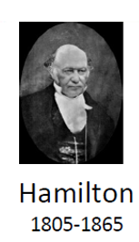
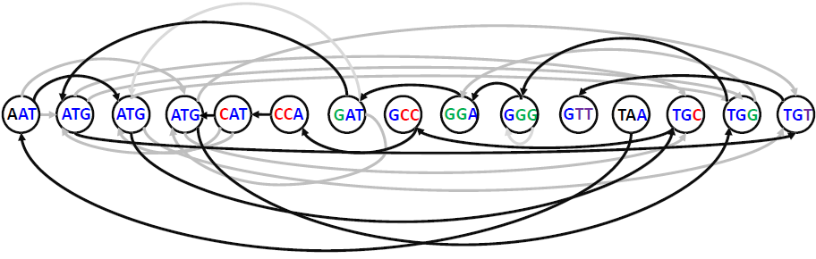
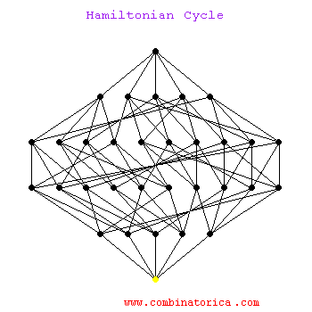
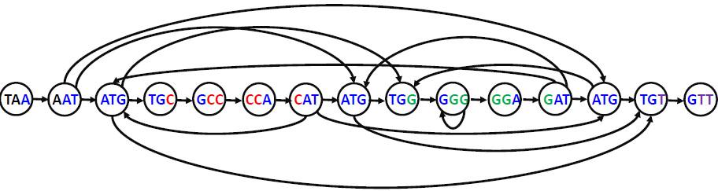
First theorem : Hamiltonian path
Hamiltonian path: a path that visits each node in a graph exactly one.
Notes:
Hamiltonian path kullanımı ve zorluğu (complexity açısından)
birleştirilmiş graph görseline geçiş
Hamiltonian path: a path that visits each node in a graph exactly one.

Slide 7
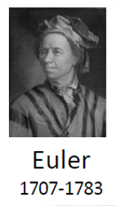
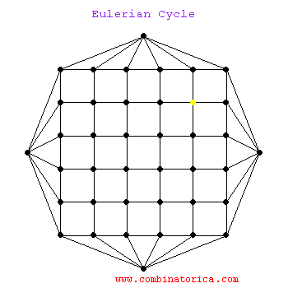
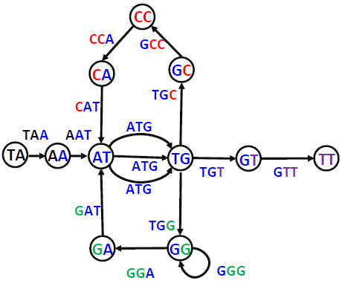
Second theorem: Eulerian path
Eulerian path problem: Find an Eulerian path in a graph.
Input: A graph.
Output: A path visiting every edge in the graph exactly once.

Slide 8
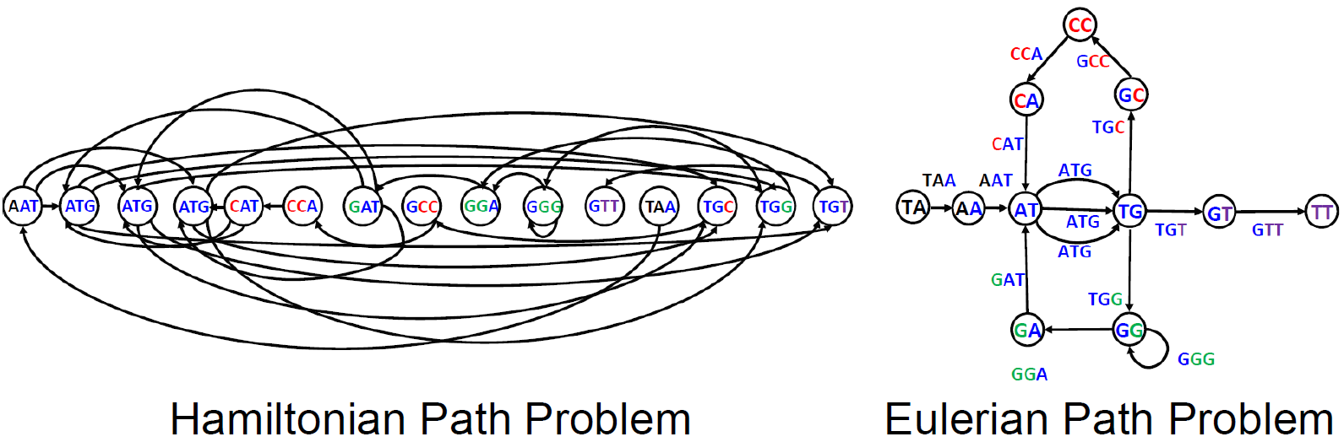
Comparison, np-complete problems
Hamiltonian path
Eulerian path

Slide 9
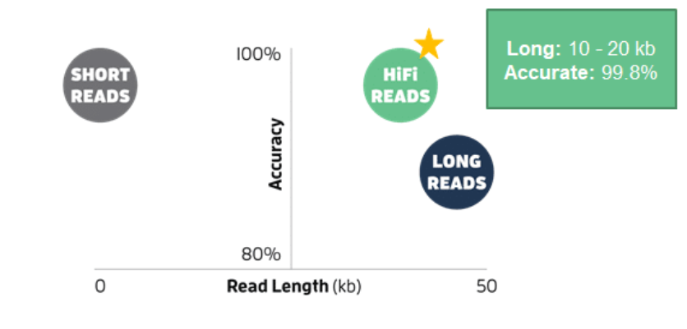

La Jolla Assembler (LJA)
Previous versions
What it solves?
HiFi reads are long and accurate
Large graph
Error free
Multiplex

Slide 10
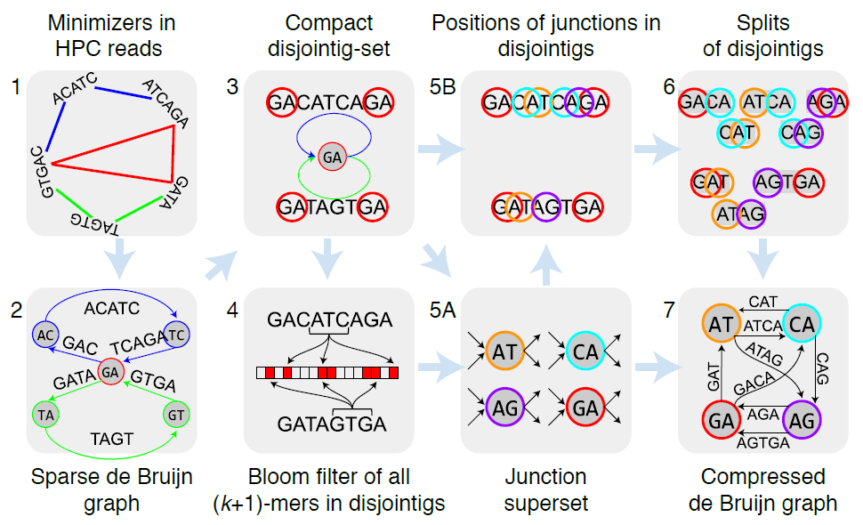
La Jolla Assembler (LJA)
Notes:
Explanation on probabilistic data structures
İntroduce search problem in terms of complexity
Hashmaps
bitsets
bloom filter

Slide 11
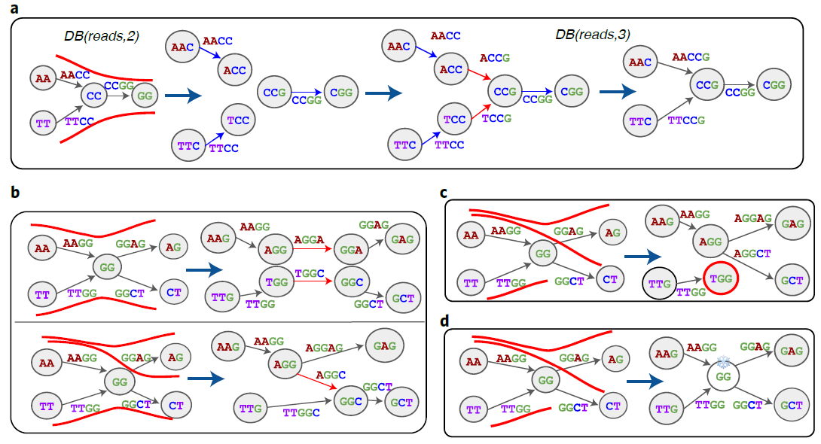

Slide 12
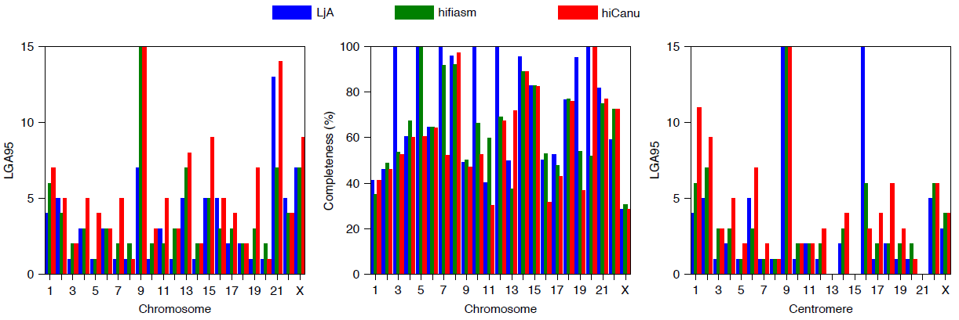
Evaluation
Notes:
* Application kısmına burada değin

Slide 13
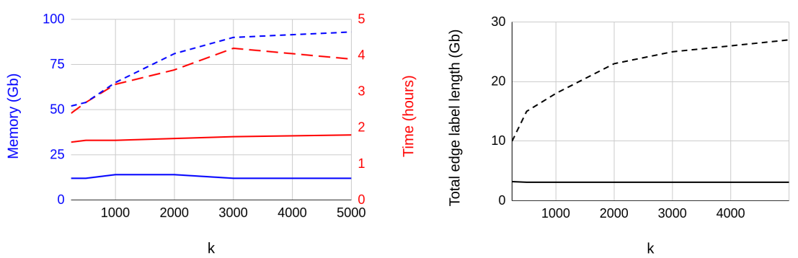
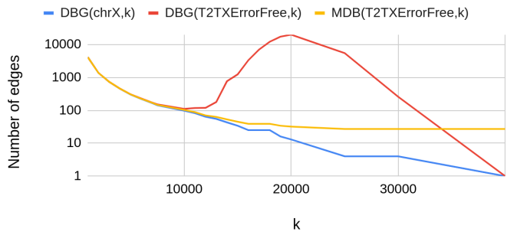
Performance
Figure 1. The running time and memory footprint of jumboDB
Figure 2. Comparison of the sizes of the compressed de Bruijn graph and the multiplex de Bruijn graph

Slide 14
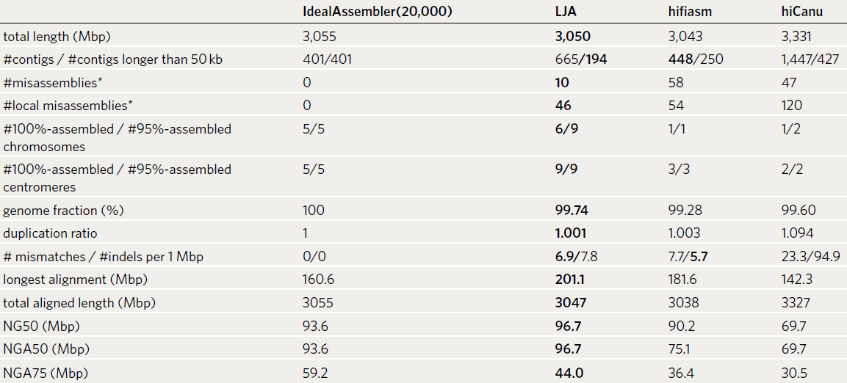
Benchmarking

Slide 15

Discussion
Evolving of the algorithms
Contest between memory and runtime complexities
LJA brings a hope

Slide 16
Thank you for listening

